Slide 1

NLP and Word Embeddings
Embedding matrix
deeplearning.ai

Slide 2
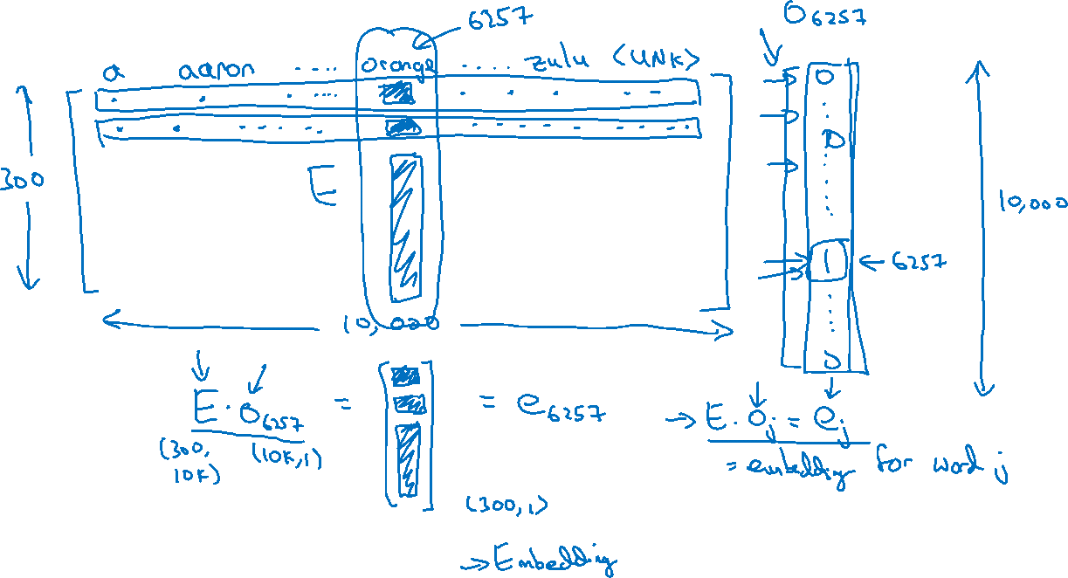
Embedding matrix
In practice, use specialized function to look up an embedding.

